Slide 1


Elixir and Phoenix Framework
Alex Richard
Trevor Donovan

Slide 2


Lesson Plan
Intro to Elixir + Phoenix
Background, The Language, Phoenix Basics
CLI Demo
Rock Paper Scissors escript
Web App Demo
Phoenix Framework
Assignment
Test yourself
Further Learning
Resources

Slide 3
TIMELINE
History of
1999
Elixir Today
Erlang becomes open source and widely appreciated for its level of availability
Designed with concurrency in mind. Processes are independent
Still used today due to its availability and scalability
WhatsApp,
Facebook (chat),
Amazon (SimpleDB)
Heroku
T-Mobile (SMS)
World of Warcraft
Functional programming language
Concurrency
Fault tolerant
Distribution transparency
Very good for web applications
Version 1.8
New version every 6 months
Hex Package Manager (currently over 12,000)
1986
2012
Phoenix Today
Ericsson (telecom) needed a programming language for telephone switches and routers
Ericsson begins developing Erlang using Prolog
The first version of Erlang (rewritten in C++) was used in a real project (1999)
Jose Valim, using Ruby on Rails, needed a way to improve performance on multi-core systems
Decided on using the Erlang Virtual Machine
Erlang drawbacks: messy syntax, missing constructs, and built-in tools (like Nodejs and Ruby)
Created Elixir
Web dev framework written in Elixir
Server-side MVC pattern
Channels for implementing real-time features
Pre-compiled templates
Ecto
Notes:
Ericsson’s AXD301 switch contained over a million lines of Erlang code and was down for only 0.63 seconds in 20 years

Slide 4
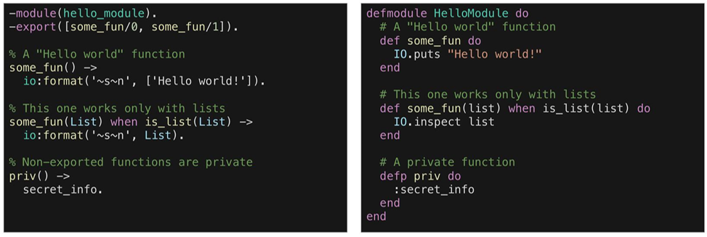
Syntax Comparison
Erlang
Elixir

Slide 5
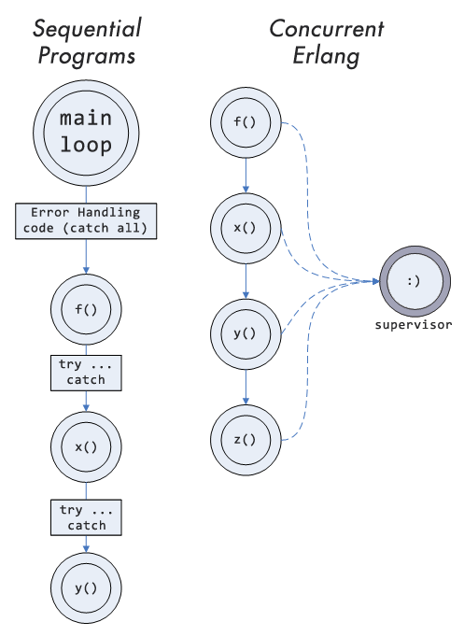

Slide 6
Types (Dynamic)
:an_atom
Lists, Tuples, Maps
Numbers
Booleans
Strings
Atoms
Lists
Tuples
Constant whose values are their own name
Used to enumerate over distinct values or express the state of an operation
Lists are stored as linked lists
Tuples are stored in memory (often used as return values)
Maps use keys and values
[1, “List”, :hello!]
Strings
Modules/Functions
Binaries (list of bytes)
String interpolation (#)
Concatenation (<>)
No objects, classes, etc.
Need a way to manipulate data structures
Modules contain functions
{:error, “you broke it”}
%{name: “Stephen”, age: 29}

Slide 7
PLUG
ECTO
A simple abstraction for dealing with different web servers
A persistence framework used to connect Phoenix apps to a SQL database
COWBOY
A small, fast, modular HTTP server written in Erlang
Notes:
Phoenix is the top layer of a multi layer system

